Slide 1



</coding>
Gavin McClary
Senior Lecturer

Slide 2
What will you learn?
What is OOP?
Python Classes
Object Instances
Defining and Working with Methods

Slide 3
What is OOP?
Object-oriented Programming (OOP) is a programming paradigm which helps you structure programs.
Objects are created that hold the following:
Properties
Behaviours
An object could represent, for example a:
Person
Student
Animal
Vehicle

Slide 4
Python classes and Object Instances

Slide 5
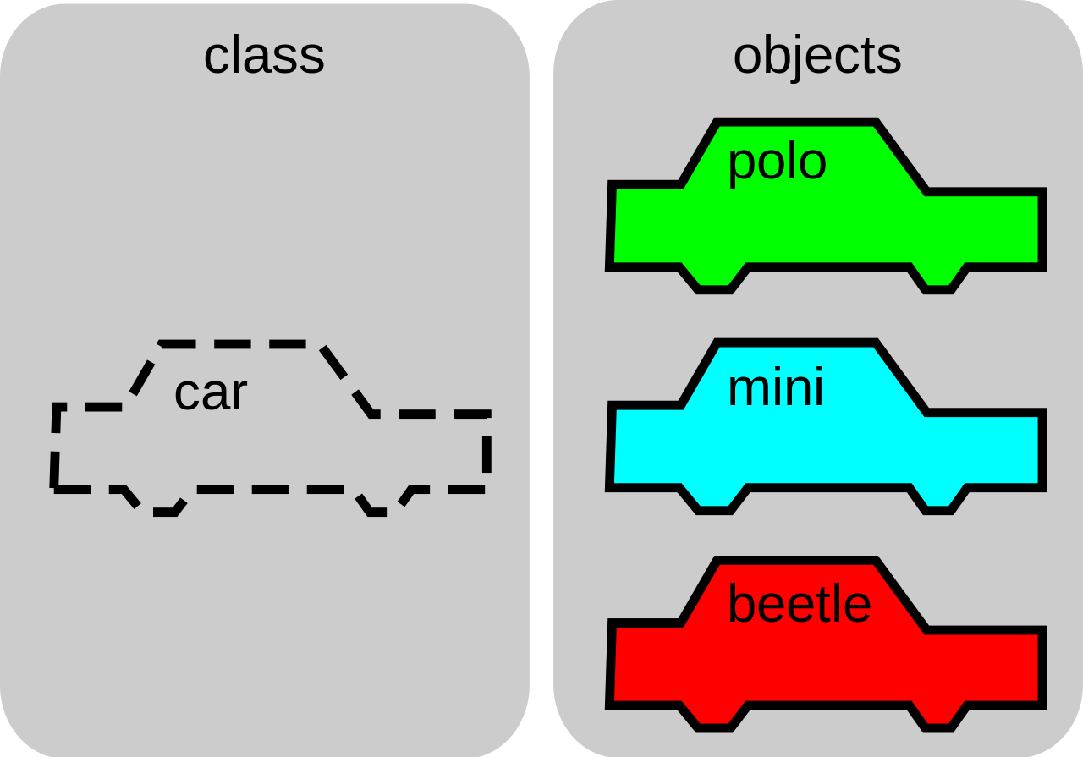
Notes:
A class is like a blueprint of the final object

Slide 6
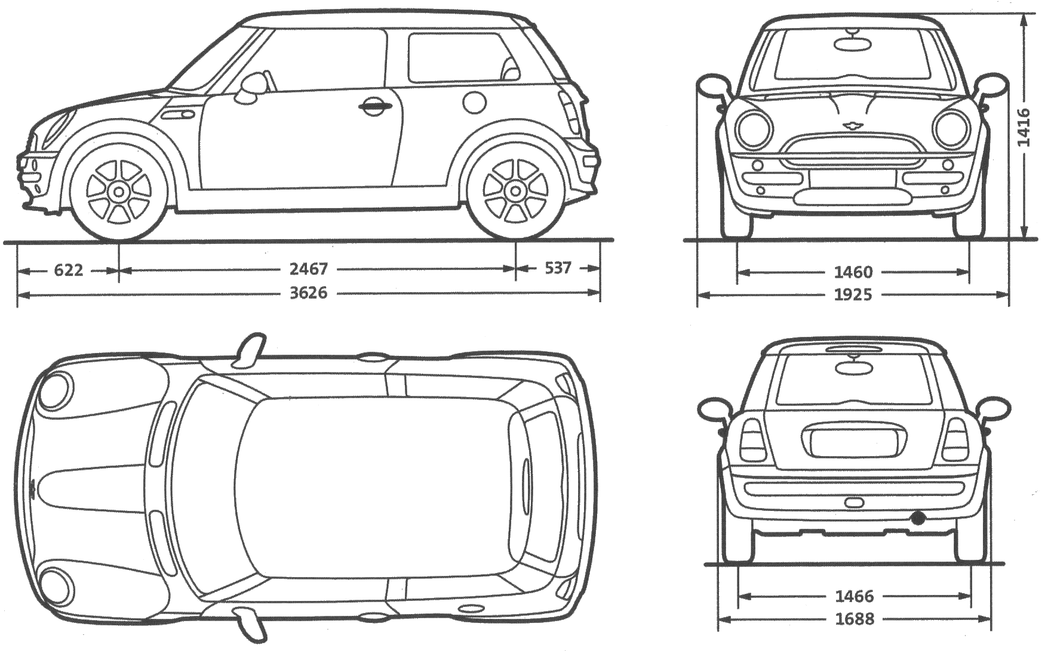
Notes:
A class

Slide 7
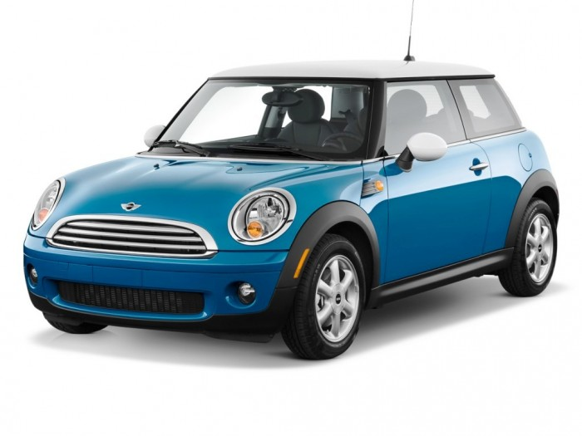
Notes:
An object

Slide 8
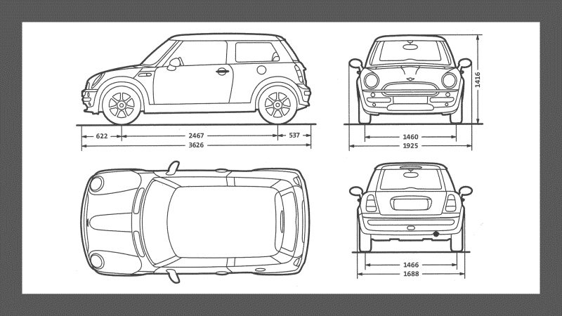
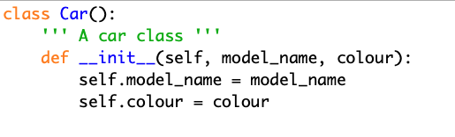
The “Car” Class

Slide 9
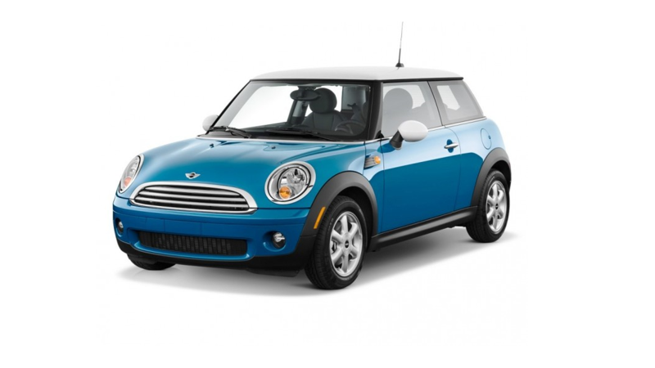
Creating a “Car” Object

Slide 10
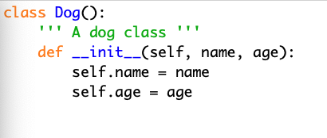
Another example

Slide 11



Let’s break it down…
A Python class definition
A Python docstring
An initialize statement
Instance attributes

Slide 12

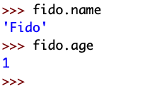
Meet Fido
Animal class: Dog
Name: Fido
Age: 1
Creating or instantiating the fido Object:
Accessing fido’s instance attributes:

Slide 13

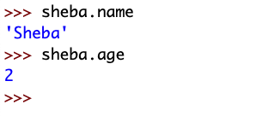
Meet Sheba
Animal class: Cat
Name: Sheba
Age: 2
Creating or instantiating the Sheba Object:
Accessing Sheba’s instance attributes:

Slide 14
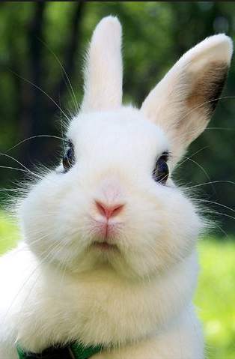
Meet Mr Snugglesworth
Animal class: Rabbit
Name: Mr Snugglesworth
Age: 5
Task:
Create the Rabbit class
2. Instantiate the Mr Snugglesworth object
3. Access his instance attributes

Slide 15
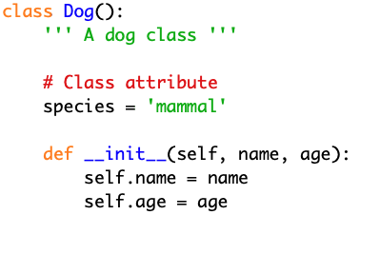
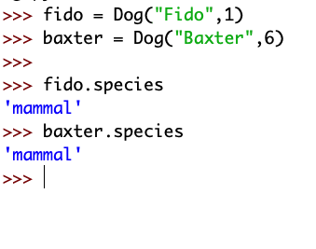
Class attributes
While instance attributes are specific to each object, class attributes are shared across all instances.

Slide 16
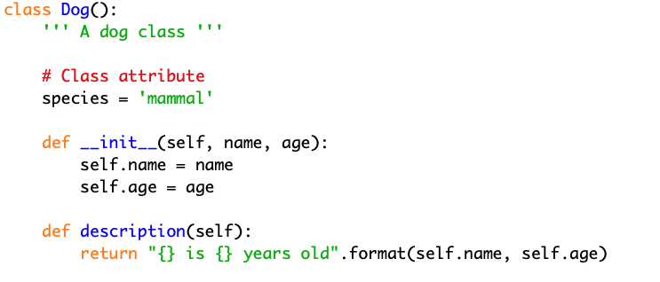
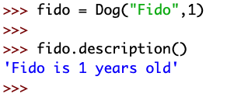
Defining and Working with Methods

Slide 17
Task
Create a new class in IDLE called Employee
The Employee class will have 3 fields/attributes (you decide what is appropriate)
The Employee class will have 2 instance methods (again, you decide what is appropriate)
Instantiate the Employee class
Print the fields/attributes out to the console
Call the methods you have defined on your instance
Tell me when you are done and I will check your code…

Slide 18
What have you learned?
What is OOP?
Python Classes
Object Instances
Defining and Working with Methods

Slide 19

Next Steps
Free online resources:
www.codeacademy.com
www.sololearn.com
https://realpython.com
https://automatetheboringstuff.com

Slide 20

Your feedback

